Slide 1

3 “Game Changers”
1- Change in Demography (we are getting older)
2- The Scientific and Technological revolution
3- Environmental disruption, namely Climate Change, loss of Biodiversity, pollution of the Sea
Carlos Pimenta

Slide 2
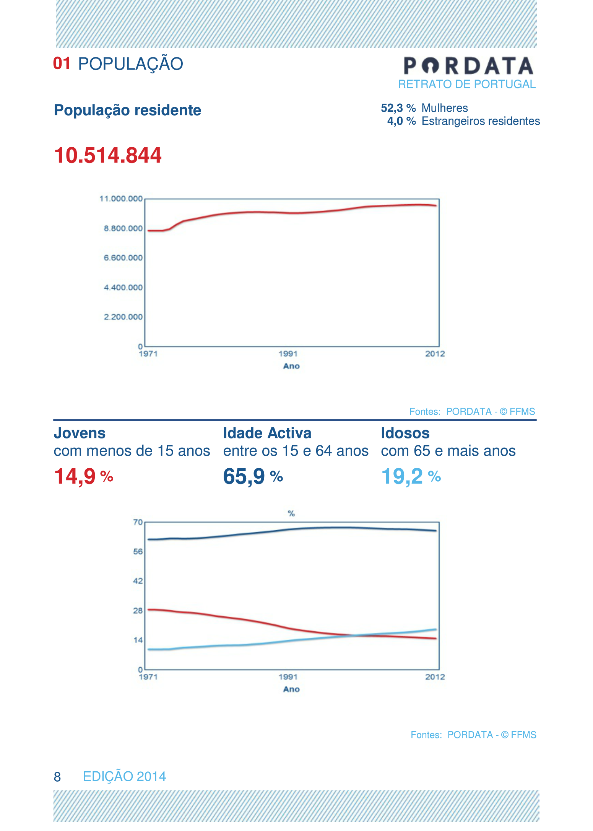

Slide 3
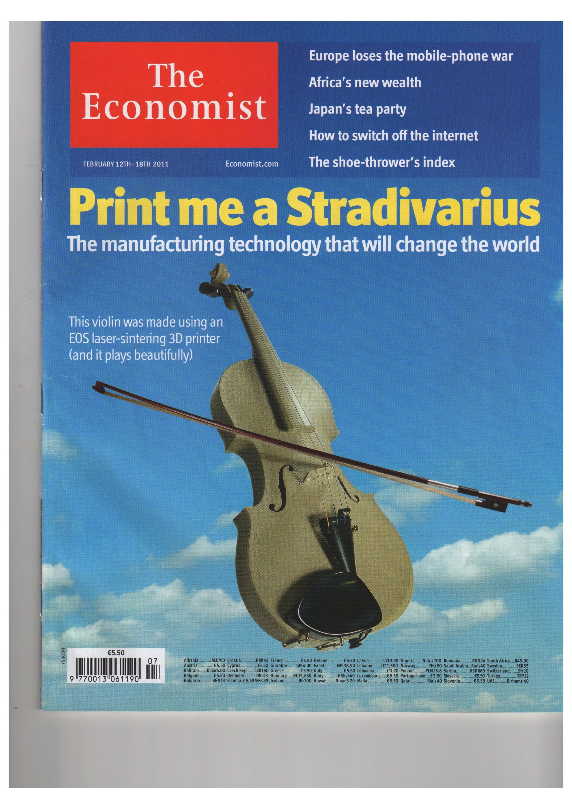
An unparalleled technological and scientific revolution
New matter
New “Life”
Health, longevity and demography revolution
Real-time decentralized data processing
Participated Globalization wit millions of users
Dematerialization
New energy forms
A basic 3D printer, also known as a fabricator or “fabber”, now costs less than a laser printer did in 1985

Slide 4


3D Printing grew 40% in 2013
Siemens: to cut time of order from 44 weeks to 4 to replace turbine blades! And prototyping from 20 weeks to 48 hours”.
GE: is using 3D printing for Boeing 737 and Airbus A320 fuel nozzles 25% lighter and 5 times more durable!
Airbus: is making bits of planes and dreams of printing the entire fuselages!
http://www.theverge.com/2014/8/13/5999933/robots-taking-jobs-video

Slide 5
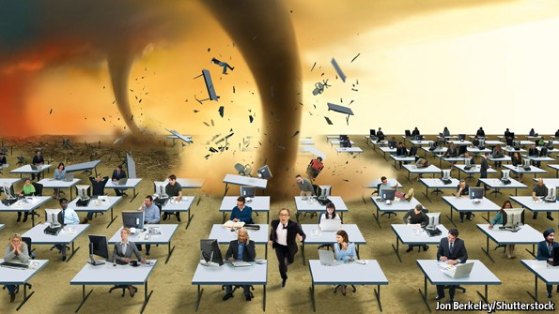
Technology and jobs
Coming to an office near you
The effect of today’s technology on tomorrow’s jobs will be immense—and no country is ready for it
Jan 18th 2014 | From the print edition
INNOVATION, the elixir of progress, has always cost people their jobs. In the Industrial Revolution artisan weavers were swept aside by the mechanical loom. Over the past 30 years the digital revolution has displaced many of the mid- skill jobs that underpinned 20th-century middle- class life. Typists, ticket agents, bank tellers and many production-line jobs have been dispensed with, just as the weavers were.
For those, including this newspaper, who believe that technological progress has made the world a better place, such churn is a natural part of rising prosperity. Although innovation kills some jobs, it creates new and better ones, as a more productive society becomes richer and its wealthier inhabitants demand more goods and services. A hundred years ago one in three American workers was employed on a farm. Today less than 2% of them produce far more food. The millions freed from the land were not consigned to joblessness, but found better-paid work as the economy grew more sophisticated. Today the pool of secretaries has shrunk, but there are ever more computer programmers and web designers.

Slide 6
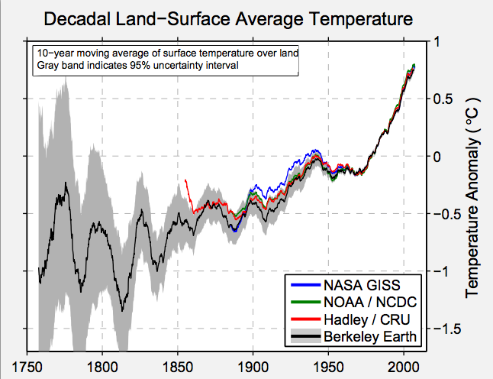

Global land temperatures have increased by 1.5 degrees Celsius
over the past 250 years
“Our results show that the average temperature of the earth’s land has risen by two and a half degrees Fahrenheit over the past 250 years, including an increase of one and a half degrees over the most recent 50 years. Moreover, it appears likely that essentially all of this increase results from the human emission of greenhouse gases.”
Prof Richard A. Muller
University of California, Berkeley
1.6 billion meteorological records
Sources: http://berkeleyearth.org/results-summary/
OP-ED CONTRIBUTOR
The Conversion of a Climate-Change Skeptic
By RICHARD A. MULLER
Published: July 28, 2012
Source: http://www.nytimes.com/2012/07/30/opinion/the-conversion-of-a-climate-change-skeptic.html?_r=3&pagewanted=all&

Slide 7
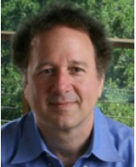
LONG TERM EFFECTS
“The carbon dioxide emitted today will affect the planet for hundreds of thousands of years;
If humanity continues to spew greenhouse gases into the air at the current rate, we will re-create the hot, wet conditions of the Cretaceous era, some 100 million years ago;
At present, humanity is altering the climate 5,000 times faster than the pace of the most rapid natural warming episode in our planet’s past.”
Prof Ken Caldeira in Scientific American 8/2012
Standford University, California
Source: http://www.scientificamerican.com/article.cfm?id=how-far-can-climate-change-go

Slide 8
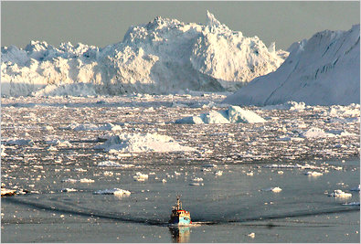
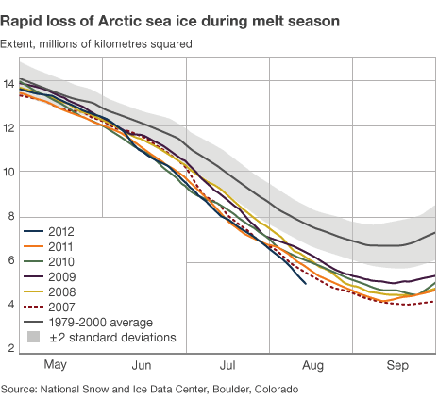
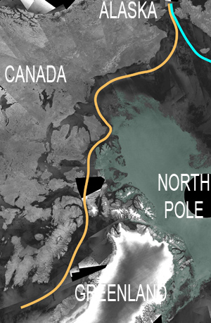
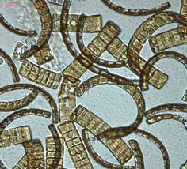
In 2011 the Northwest Passage was ice free for the first-time ever since records are made
First evidence of a trans-Arctic migration in modern times was recently disclosed by project CLAMER when a tiny species of plankton (Neodenticula seminae) found only in the Pacific, was discovered in the North Atlantic in 2011, where it has been extinct for 800.000 years.
Source: Project CLAMER – Climate Change and European Marine Ecosystem Research
http://www.clamer.eu/images/stories/press_releases/CLAMER_Press_release2_2011-06-27.pdf

Slide 9
Still more than 1.500 million people outside the commercial energy market.
1- CO2 (decarbonisation)
2- shale gas. USA. Is now the most important natural gas producer
3- 2004 was thought price of oil was going to stay around 20Usd / Barrel.
The same for other commodities, but... China, Brics, etc. all raw materials went up
4- TICs (Tecnologias de Informação e Comunicação )
5- Energy Efficiency
6- Renewables and Distributed electricity generation
SMART AND INTERCONNECTED GRIDS
7- Electric mobility and batteries (Distributed electricity storage)
8- A world of Prosumers

Slide 10
A política energética tem de considerar vários objectivos
Abrir mercados energéticos europeus
Mitigar impacto do aumento dos preços de energia
Manter Europa na frente da inovação tecnológica
Competitividade
Sustentabilidade
Segurança de abastecimento
Reduzir dependência energética
Diversificar mix energético
Criar mecanismos para promover investimento
Promover a utilização de recursos endógenos
Promover renováveis e tecnologias com baixas emissões
Aumento da eficiência energética
Reduzir emissões
Daqui decorre que uma política que não defenda as renováveis e menospreze a dependência dos combustíveis fósseis não possa cumprir com estes objectivos

Slide 11
Objectivos de Política Energética
Segurança do Abastecimento
Garantir as necessidades finais em termos de quantidade e qualidade
Não só pela gestão da oferta: há escolhas + eficientes ao longo da cadeia
Ambiente e Sustentabilidade
Local/regional
Global (CO2) – um factor incontornável!
Competitividade da Economia
Que contas fazemos? Verdade, transparência, factores de distorção, limitações da regulação... Economia do CO2 ?

Slide 12
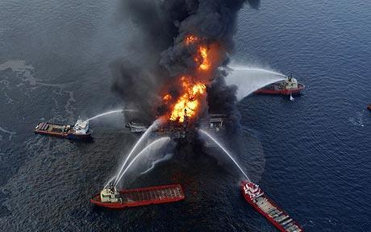
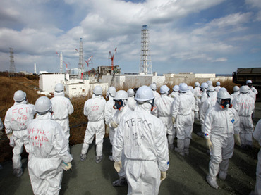
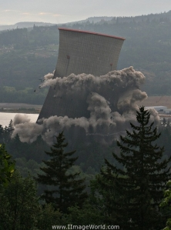
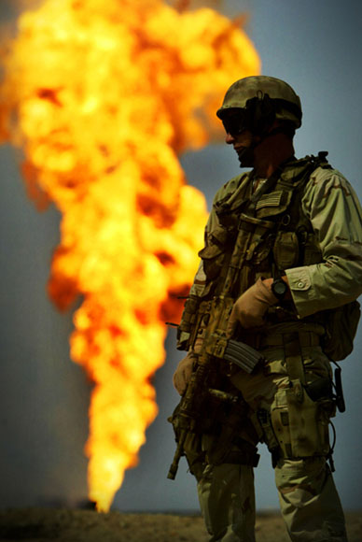
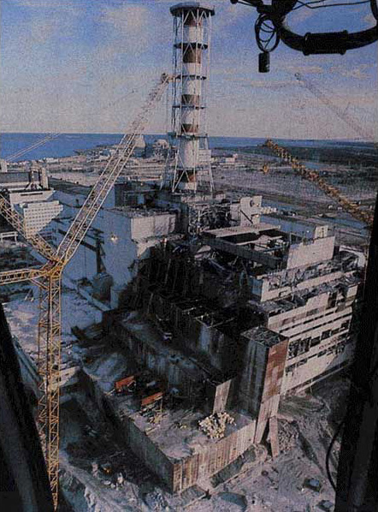
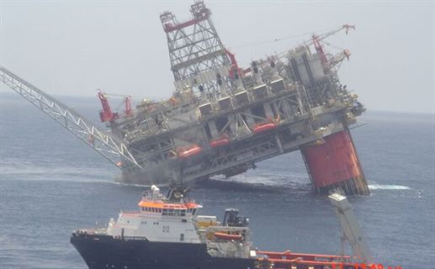
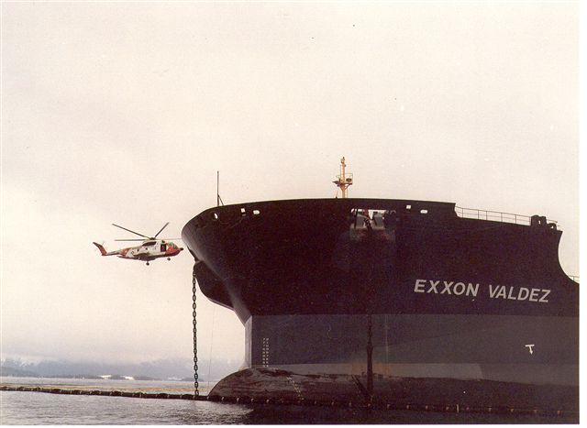
The Resilience Factor: Conventional energy systems
accidents/incidents that have huge global impacts – environment/health, markets/prices, availability
“… The BP oil spill in the Gulf Coast is the worst environmental disaster of its kind in our nation‘s history(…) We are working to hold BP accountable for the damage to the lands and the livelihoods of the Gulf Coast, and we are taking strong precautions to make certain a spill like this never happens again.”
Barack Obama
14-June-2010

Slide 13
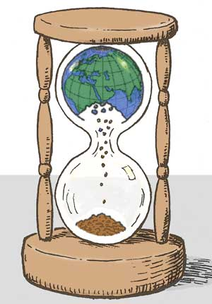
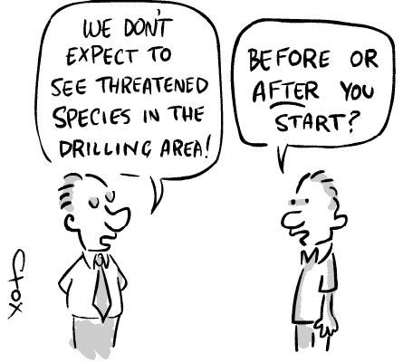
Biodiversity Loss

Slide 14
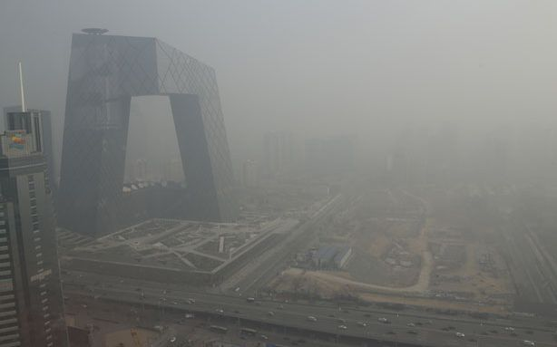
Air pollution and health problems in emerging economies
Chinese officials have shut down factories and ordered cars off the roads to try and save their capital city after spending three straight days under a cloud of toxic smog.
Visibility has been as low as 100 yards in some parts of the city, as an increase in winter coal burning, combined with low wind conditions pushed the nation's already crushing pollution problems to dangerous levels.
To put the current crisis in perspective, the World Health Organization considers an acceptable level of airborne particulates to be 25 micrograms per cubic meter (μg/m3).
On Saturday, readings in Beijing reached 993 μg/m3. The head of cardiology at Peking University People’s Hospital said "The number of people coming into our emergency room suffering heart attacks has roughly doubled since Friday."
Source: http://www.theatlanticwire.com/global/2013/01/beijings-pollution-problem-gets-out-hand/60943/

Slide 15
A Energia de que precisamos
energia primária
(oferta)
Energia final
energia útil
(procura)
petróleo
carvão
gás
nuclear
iluminação
multimédia
ventilação
arrefecimento
aquecimento
água quente
Indústria
Mobilidade
Electricidade
20 a 25%
hidro
biomassa
vento
sol
geotermia
Outros sistemas de transformação e transporte

Slide 16
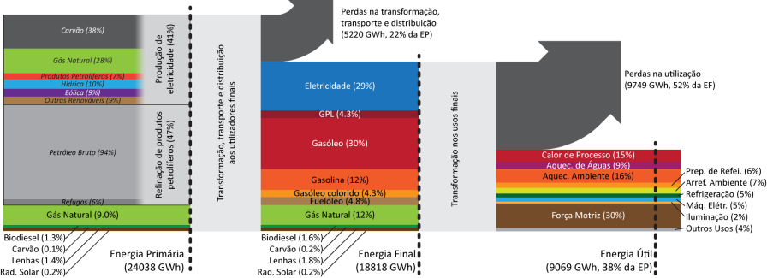
A Economia Verde no Edificado
Matriz AMP-ND (Grande Porto)
EN. PRIMÁRIA
EN. FINAL
EN. ÚTIL
E. útil representa apenas 38% da E. primária e E. térmica representa 46% da E. útil
As autarquias ao facilitarem a mobilidade e ao prestarem maior atenção à qualidade do edificado estão a melhorar a qualidade de vida dos seus cidadãos e a reduzir os respetivos custos na vertente da energia

Slide 17
As 3 vias da eficiência energética
Tecnologia
Gestão da Procura
‘Vector shifting’
Novas fontes (eólica, sol, biomassa…)
Redes
Armazenamento
Monitorização, controlo
EXPO’98
Covenant of Mayors
20 x 20 x 20 da EC
Mercados
Actividades económicas at large
Substituição da electricidade para usos de calor por GN, sol, biomassa,..
Subst. de fuels por electricidade (mobilidade)
oferta + procura
procura + tecnologia
oferta (preços/…)+ procura
Edifícios como ‘suntraps! – EPB Directive
Mobilidade
Cidades at large
Cidades ( planeamento urbano, mobilidade, edificação, actividades produtivas, espaços abertos,…)
Sectores de actividade
sistemas energéticos (smart metering, co-geração, …)
Sol vs gás
Sol vs electricidade
Gás vs electricidade
Biomassa vs electricidade
Electricidade vs combustíveis

Slide 18
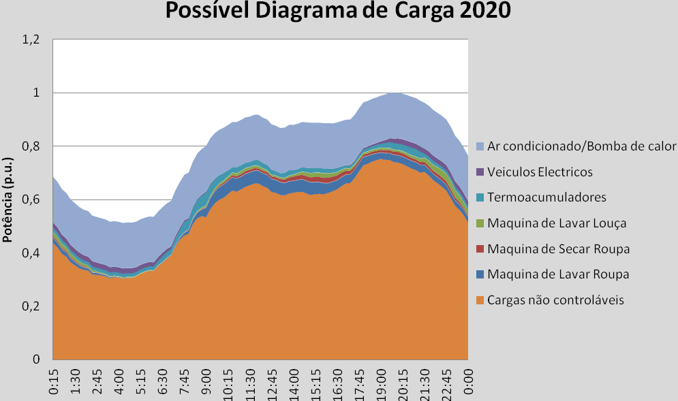
A rede eléctrica do futuro e a gestão da Procura
Carga que pode ser reduzida
Smart Grids
Smart Meters
Demand Side Management
Veículos Eléctricos
Fonte: INESC Porto
Flexibilidade do Sistema
Importante papel das TICs

Slide 20
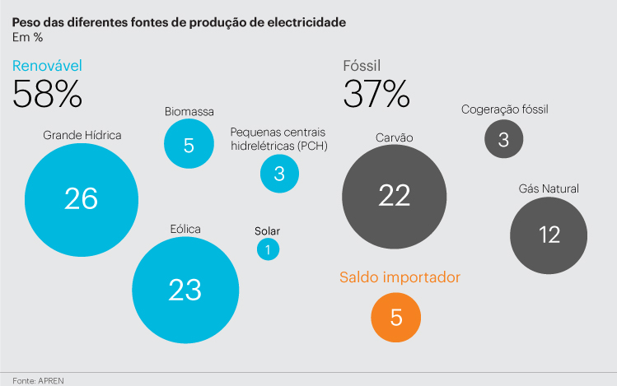

Slide 21
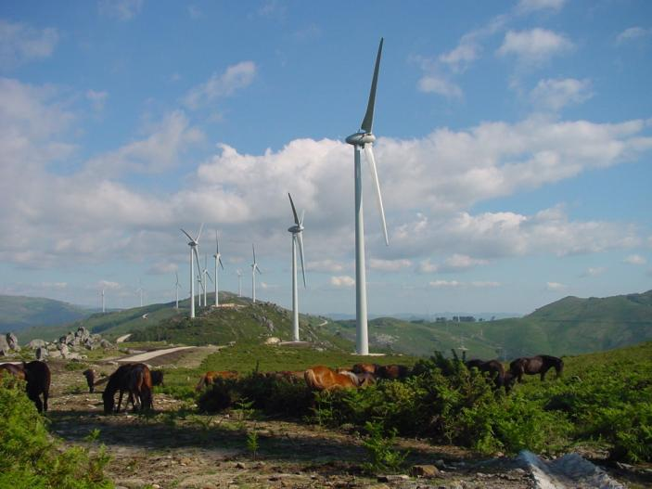
Política Energética para Portugal
Uma visão de futuro
Ventominho 240MW

Slide 22
Position of the Government on the 2030 climate and energy framework
Portugal advocates a 4-target climate and energy package for 2030:
1- At least 40% greenhouse gas reductions in domestic emissions compared to 1990 emissions (including a structural reform of the EU ETS and the extension of the scope of the non ETS sectors to land use and forestry sector –LULUCF);
2- 40% of total energy consumption to be provided by renewable energy;
3- 30% in energy efficiency;
4- at least 25%, for all Member States, of electricity interconnection capacity for the total production capacity (setting a target of 12% by 2020 and 10% for all Member States in the very short term).

Slide 23


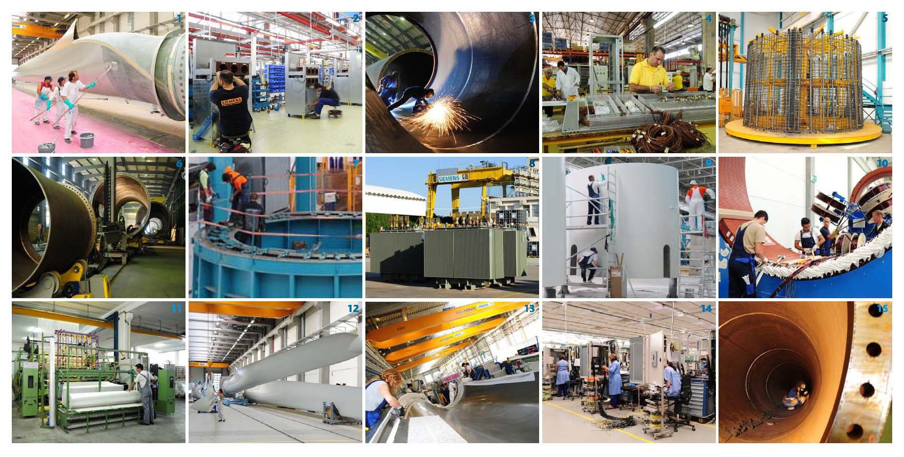
19 fábricas construídas ou ampliadas
entre 2007 e 2010
ENERCON Pás de Rotor (1, 12, 13) – ENERCON Torres de Betão (5, 7, 9) – ENERCON Geradores Síncronos (10) – SAERTEX Fibra de Vidro (11) – A. SILVA MATOS Torres de Aço (3, 6, 15) – SIEMENS Transformadores e Quadros de Média Tensão (8, 14) – JAYME DA COSTA Equipamentos Eléctricos (4)

Slide 24
Mais de 1950 postos de trabalho industriais criados
em tempos de crise económica
Novos postos de trabalho criados nas empresas do cluster
2000
Empresas Cluster Fábricas ENEOP
1500
1000
500
0
2006
2007
2008
2009
2010
2011
2012
2013

Slide 25
Um impacte notável
na economia nacional e regional
Valor Acrescentado Nacional: cerca de 300 milhões de euros por ano
VAB do cluster em ano cruzeiro | ~ 120 milhões € / ano
VAB dos parques eólicos | ~ 170 milhões € / ano
Efeito sobre o PIB regional (MINHO-LIMA):
O cluster representa cerca de 4% do PIB d | a região Minho-Lima
•
•
Emprego em zonas desfavorecidas:
O pólo industrial é o motor da criação de emprego na região de Viana do Castelo, que sofreu duramente com as desindustrialização (crise dos Estaleiros Navais…)
Distribuição de riqueza em zonas rurais:
Receitas dos municípios | 5 milhões € / ano
Rendas dos proprietários dos terrenos | 3,4 milhões € / ano

Slide 26
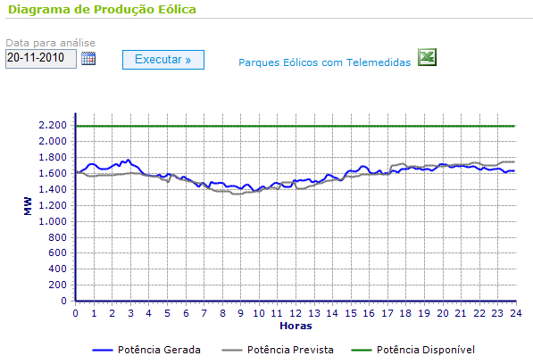
Renováveis: intermitência não significa incapacidade de gestão
Previsão Eólica actualizada cada 6 horas
Fonte REN
Ferramentas de previsão sofisticadas

Slide 27

A rede eléctrica do futuro
Passado
Futuro: produção distribuída com gestão inteligente do sistema com grande flexibilidade
Central power station
Photovoltaics
power plant
Transmission Network
Storage
Storage
Flow
Control
Distribution Network
Storage
Storage
Power
quality
device
Power
quality
device
Local CHP plant
House
Wind
power
plant
Factory
House with domestic CHP
Commercial
building

Slide 28


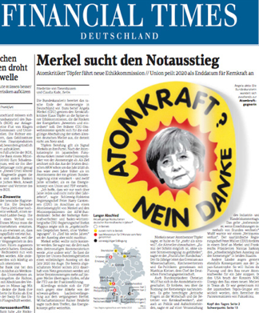
Nuclear Energy
Usually presented as a:
Cheap and clean source of electricity
A solution for hydrogen production
However
Costs of new plants are grossly and repeatedly underestimated
Nuclear faces prohibitively high—and escalating—capital costs
Several costs (like dismantling) are usually unaccounted for
Blackmailing taxpayers: projects too big too fail
Global security and risks of nuclear proliferation
Radioactive waste: a dangerous heritage with no solution and a long life
Risk of accidents is underestimated
Lack of transparency from authorities in the case of an incident/accident
Pressure on natural resources like water (impact of water shortages)
Dependency on imported uranium
Lack of fuel for existing plants from 2025 onwards
Nuclear is already a mature technology—it will not get cheaper
Nuclear subsidies take money away from more effective alternative energy subsidies
Other clean energy technologies are cheaper, cleaner, safer and faster to build

Slide 29
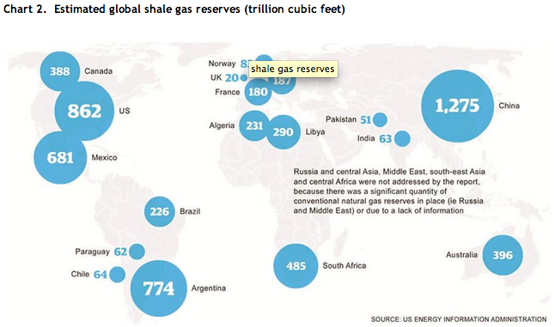
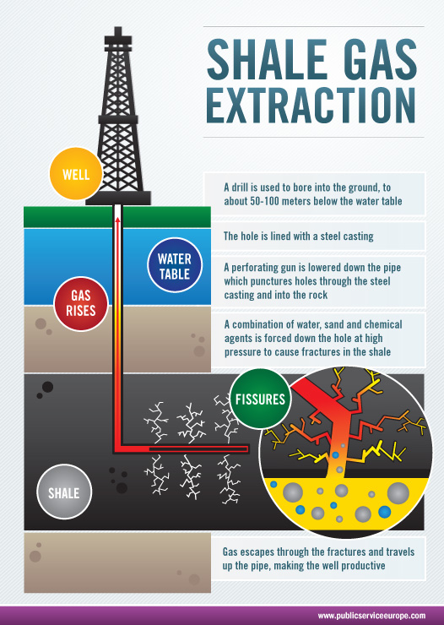
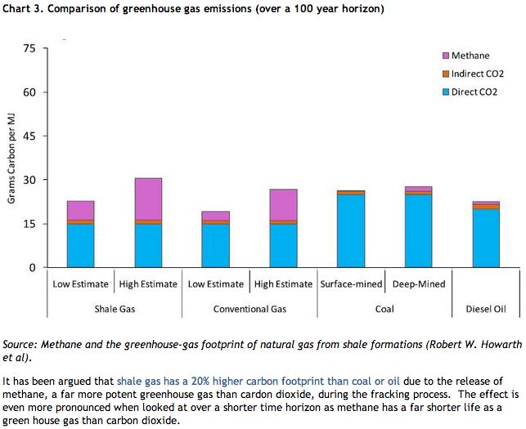
Source: ttp://www.timera-energy.com/uk-gas/all-shook-up-over-shale-gas/

Slide 30
Tendências do sistema eléctrico europeu
2009
Fonte: Wind in Power
2009 European Statistics
EWEA 2009
Progressão e domínio das energias renováveis na nova capacidade instalada
As novas centrais renováveis substituem centrais térmicas obsoletas (carvão e nuclear)
    Evolução futura: continuação do crescimento a nível mundial

Slide 31

"The market for large power plants will never return"
Europe’s energy sector predicts its future
09/06/2014
If we take the opinions of these industry professionals as read, Europe’s future power sector will be decentralized, with big utilities going the way of the dinosaur.
The future EU electricity market will combine regulated and open elements. Fossil fuel fired power plants will continue to back up intermittent renewable generation as Europe moves, at a slower and steadier pace, toward a low-carbon future;
Costs for renewables will continue to fall, and energy storage will increasingly come into play.

Slide 32
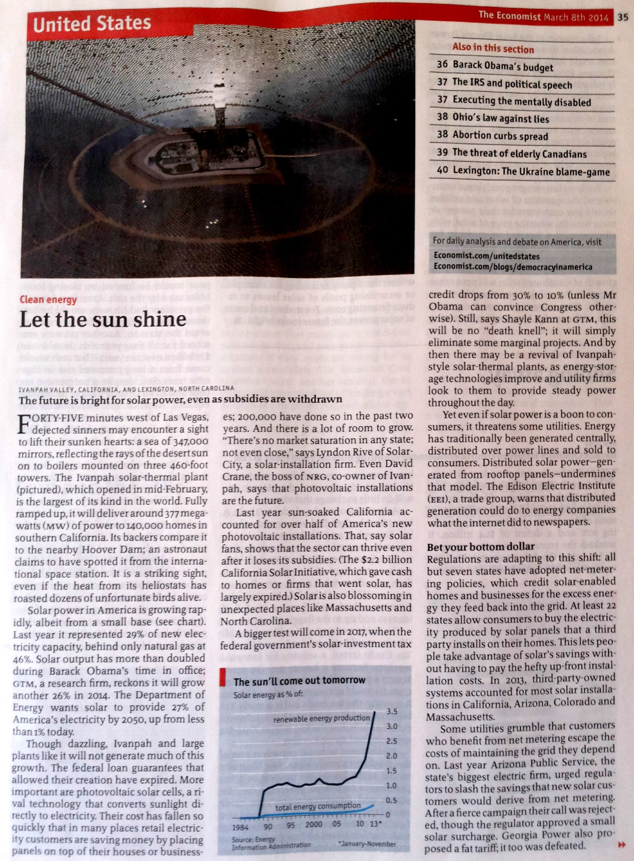
Generated by CamScanner from intsig.com

Slide 33
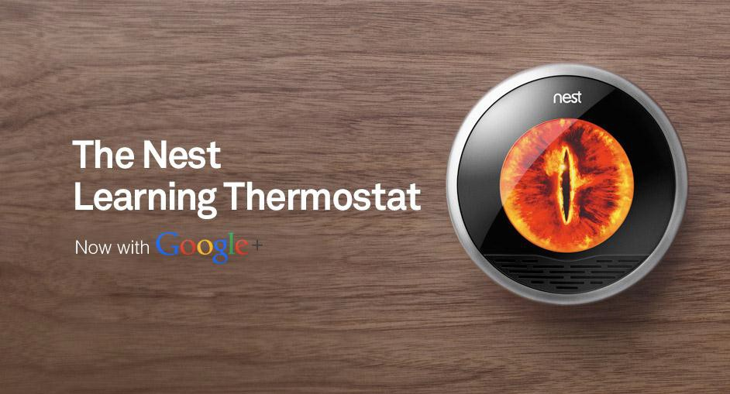
Non-energy companies in the business

Slide 34
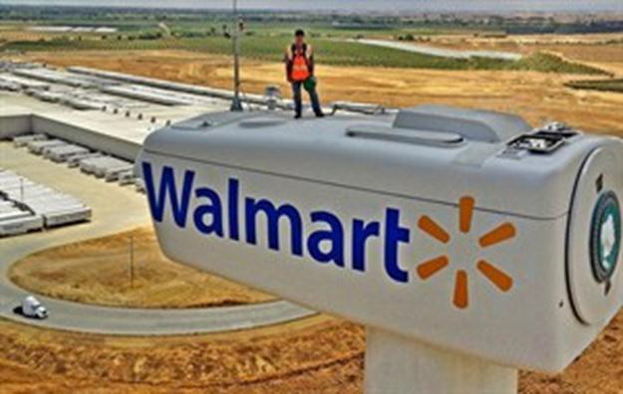

Non-finance companies in the business
Walmart working towards 100% renewable energy.
Essent (NL belonging to RWE), made a deal with Mediamarkt to sell energy through its shops for five years in the Netherlands.

Slide 35
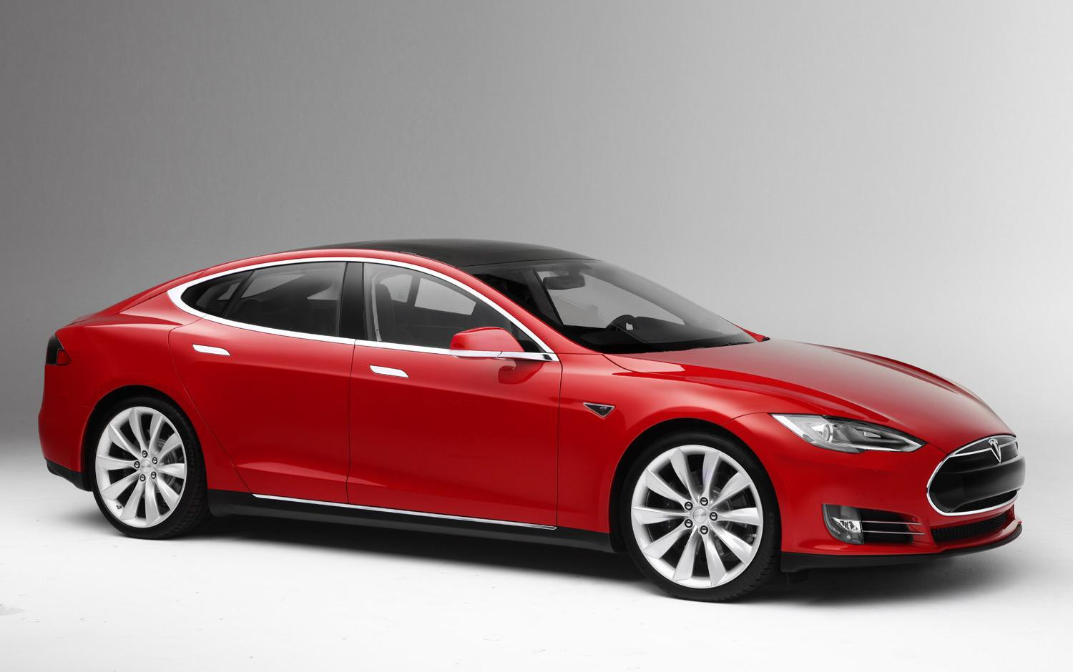
All-Electric plug-in is Car of the Year 2013
Motor Trend Magazine Automobile Magazine Consumer Reports.org

Slide 36
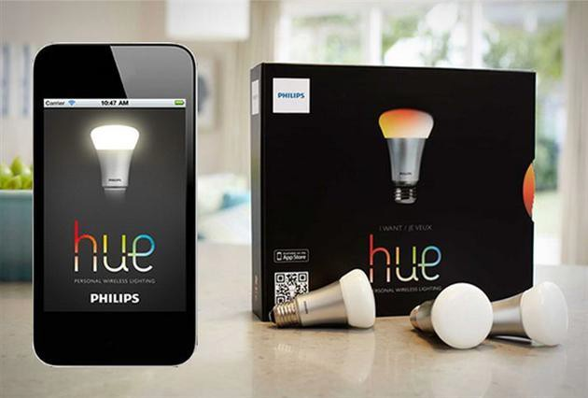
Personal wi-fi wireless controlled lighting

Slide 37
…and utilities in non-utilities business
My vision, he said, “is that RWE will put solar panels on your roof, a battery in your shed, a heat pump in your cellar, and we will also manage this complex energy system for you.”
CEO of RWE, Peter Terium in Energy Post, 7 April 2014.

Slide 38
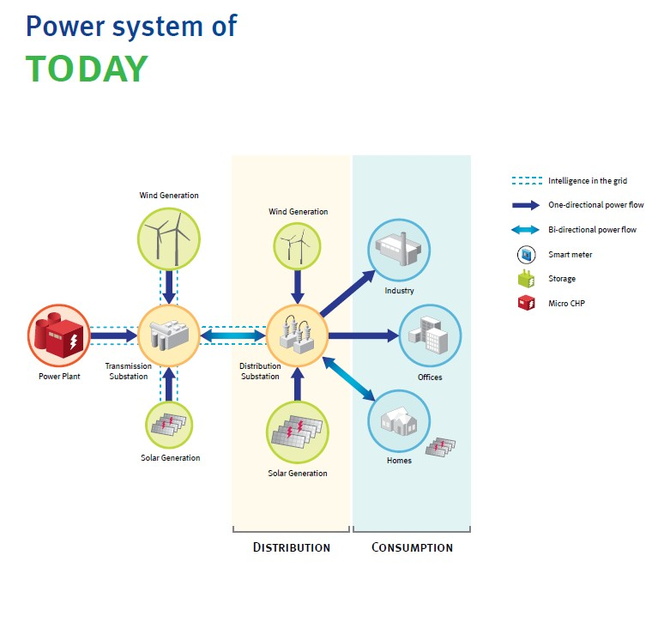
Source: Eurelectric.

Slide 39
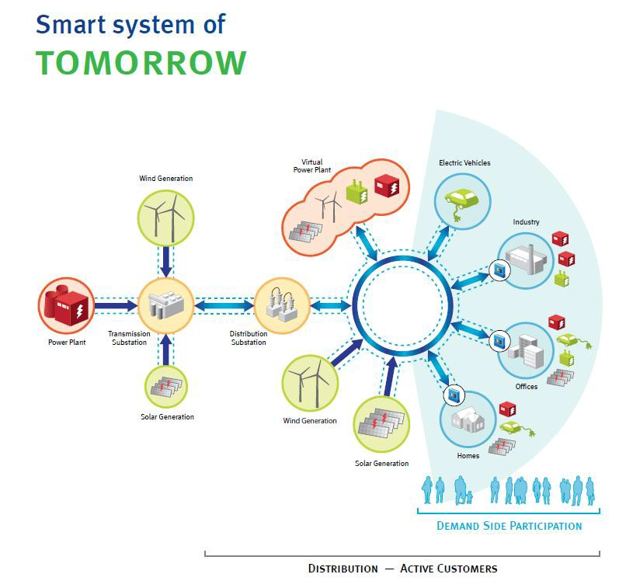
Source: Eurelectric.

Slide 40
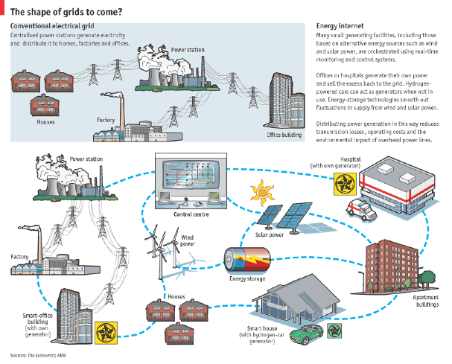
Redes inteligentes e descentralização
27

Slide 41
incitation indirecte à l’autoconsommation à travers un programme d'encouragement de stockage (prêts avec intérêts réduits, indemnité …)
Conséquences réseau
Les systèmes de stockage individuels sont subventionnés… pour limiter les impacts sur le réseau de distribution
  Les consommateurs bénéficient ainsi de l’énergie solaire produite sur leur toit (tarif d’achat < prix de l’électricité): ils pourraient réduire d’environ 60% leur besoin d’approvisionnement sur le réseau
  Cela devrait permettre de réduire les subventions accordées aux ENR via le tarif d’achat
… à condition que la puissance injectée sur le réseau soit limitée à 60% de la capacité installée
Certains industriels y voient l’opportunité de développer des produits
  Ex: Alliance Saft-Bosch
Exemple d’utilisation d’un stockage de 3,3 kWh / 1kW couplé à un système PV de 4 kWc le jour le plus ensoleillé de 2005 à Munich (27 mai)
Pour une telle installation, le surcoût lié au stockage pour l’installateur serait d’environ 3300€ après subvention
La puissance injectée entre 19h et 20h n’est plus nulle
Cette mesure vient palier le fait qu’une utilisation du stockage uniquement pour maximiser l’autoconsommation ne garantirait pas la réduction de la puissance maximale injectée
Source: EDF R&D, d’après données Helioclim
NB: les conclusions de l’institut Fraunhofer sur la différence entre auto-consommation et réduction de la pointe grâce au stockage convergent avec ceux d’OSIRIS (projet de Marc Le Du)
Source : EDF R&D
Notes:
Les systèmes de stockage sont subventionnés à hauteur de 30%, dans la limite de 600 €/kWc
Exemple système 4 kWc (cas nouvelle installation) ➔ subvention plafonnée à 4500€
Si coût batterie Li-ion ~1.500€/kWh => coût total = 4950€ ➔ subvention plafonnée à 1650€
Coût pour l’investisseur pour le stockage: 3300 €
Rentable avec ces hypothèses
Consommation annuelle: 3 000 kWh
Autoconsommation: 50% à l’année 1 puis -0,5% / an
Différence prixElec / tarif d’achat: 7c€/kWh à l’année 1 puis +0.333c€/kWh par an
Durée de vie: 20 ans
Taux actualisation: 2%
Hypothèses du graphique
http://www.helioclim.org
Site latitude (positive means North) 48.14 Site longitude (positive means East) 11.57 Elevation (m) 520 Tilt angle (degrees) 25 Azimuth angle (degrees) 180 Albedo of the ground 0.2 Date beginning 01/01/2005
Taille système (kWc): 4 rendement panneaux: 15% rendement global: 12.3% surface (m²): 26.6666667 taille stockage (kWh): 3.3 seuil (kW): 2.45

Slide 42
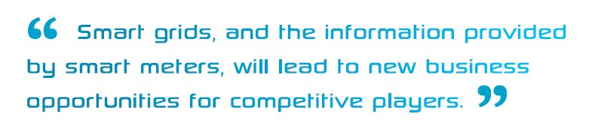
and Financial
innovation!

Slide 43
Política Energética: Um possível VADEMECUM
Bom funcionamento dos Mercados da electricidade, do gás natural e dos combustíveis, assegurando uma liberalização efectiva, regulação independente e internalização dos custos ambientais, nomeadamente os relativos ao CO2
Continuidade do programa das energias renováveis na vertente da electricidade e dinamização da vertente calor (solar, biomassa de proximidade, geotermia).
Promoção do conceito Produtor/Consumidor (Prosumer)
Promoção da eficiência energética
Reorganização da fiscalidade e dos sistemas de incentivos do sistema energético (Fiscalidade Verde)
Aprovisionamento público “energeticamente eficiente e ambientalmente relevante”
Prospectiva e inovação em energia adaptadas ao nosso país. Promoção da mobilidade eléctrica
Comunicação, sensibilização, monitorização e reporte da avaliação das políticas no sector da energia.

